Slide 1
Electronics & Electricity
Unit 9 – TinkerCAD Arduino
Section 2 – TinkerCAD Arduino

Slide 2
TinkerCAD Arduino
TinkerCAD Arduino

Slide 3
The big idea
Familiarity with TinkerCAD Circuits
Designed circuits in a virtual environment
Circuit design using a microcontroller
Virtual Arduino simulation usage and prototyping

Slide 4
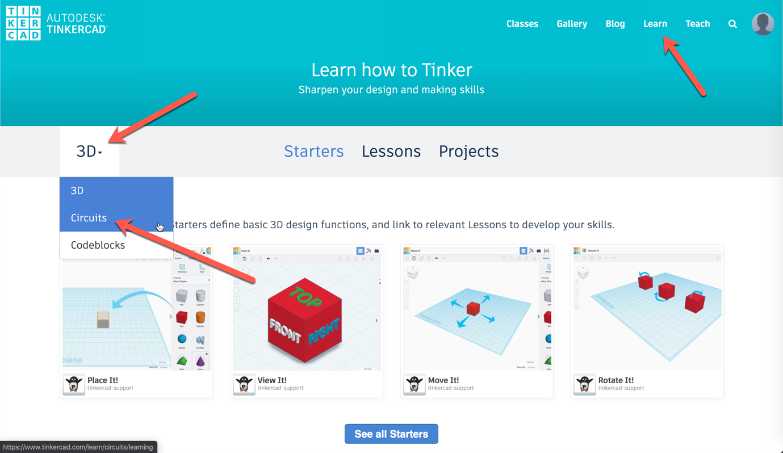

Slide 5
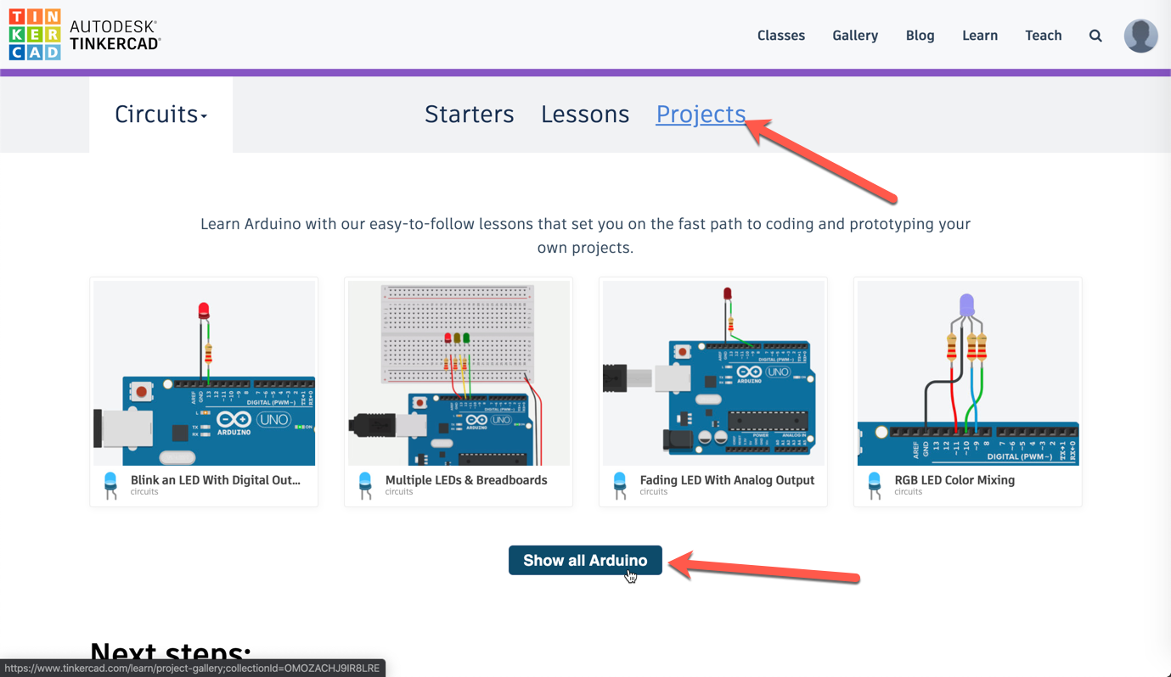

Slide 6


Slide 7
